Slide 1
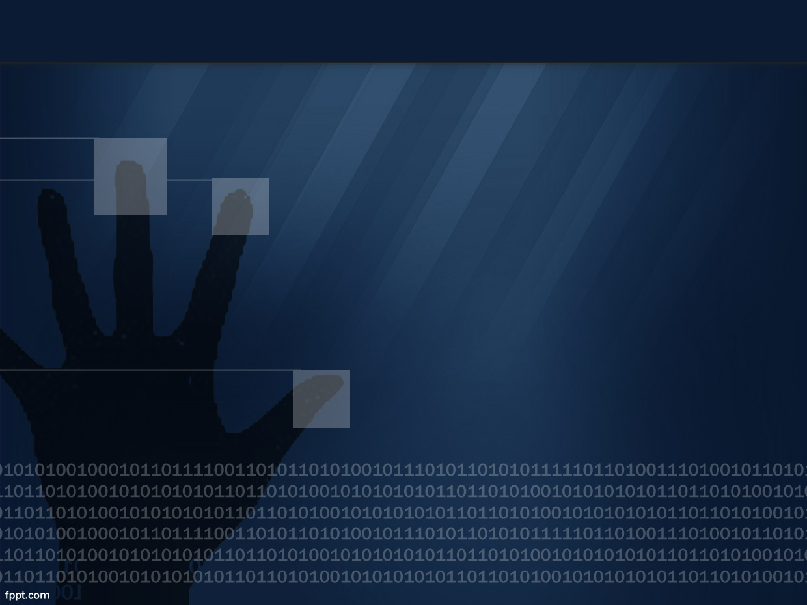



Introduction to web app exploitation
Author: Manny Mand

Slide 2
Background
Enrolled at Durham College for I.T.
Security researcher at Project Insecurity
Ethically disclose vulnerabilities
Pursuing the CCNA Cyber Ops certificate

Slide 3
Resources
Forums
HTB
YouTube
Textbooks

Slide 4
Communications
IRC
XMPP
Twitter

Slide 5
My methodology
Reconnaissance, Reconnaissance, Reconnaissance
More Reconnaissance
Even more Reconnaissance
Exploitation

Slide 6
Reconnaissance
Discovering web technologies
Enumerating subdomains
Scanning services on servers
Identifying WAFs

Slide 7
Reconnaissance Tools/Demonstration
Nmap*
Wafw00f*
Knock*
WPScan
Google*

Slide 8
What now?
Search for outdated services
Research exploits
Test web parameters

Slide 9
Q&A

